Slide 1
Logistics: Project Milestone 2
Milestone 2: Due Nov 4
Summarize your progress
Should make enough progress to know whether the project is feasible
Last chance to convert a research project to an extensive literature survey
Midterm Pitch: Nov 1 (Tue), in lecture
Opportunity to engage other classmates
Every group will get around some time from other groups
If you want to engage the entire class (for data collection, etc)
Let me know at least one week in advance
There might be time limits (e.g., 3~5 minutes)
Plan your progress to utilize this discussion lecture

Slide 2
Student Presentation
Remember to submit the peer review form by 6pm

Slide 3
Lecture 16 Future of Work
Instructor: Chien-Ju (CJ) Ho

Slide 4
This Lecture
Teamwork and Expert Crowdsourcing
Blurring the Line of Traditional/Micro Work

Slide 5

More Than Crowdsourcing

Slide 6
More Than Crowdsourcing: Gig-Economy

Slide 7
More Than Crowdsourcing: Gig-Economy

Slide 8
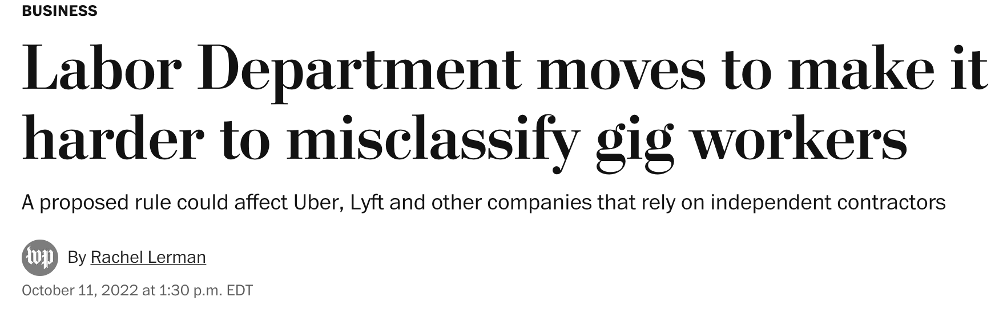
More Than Crowdsourcing: Gig-Economy

Slide 9
Even the traditional work environment is changing

Slide 10
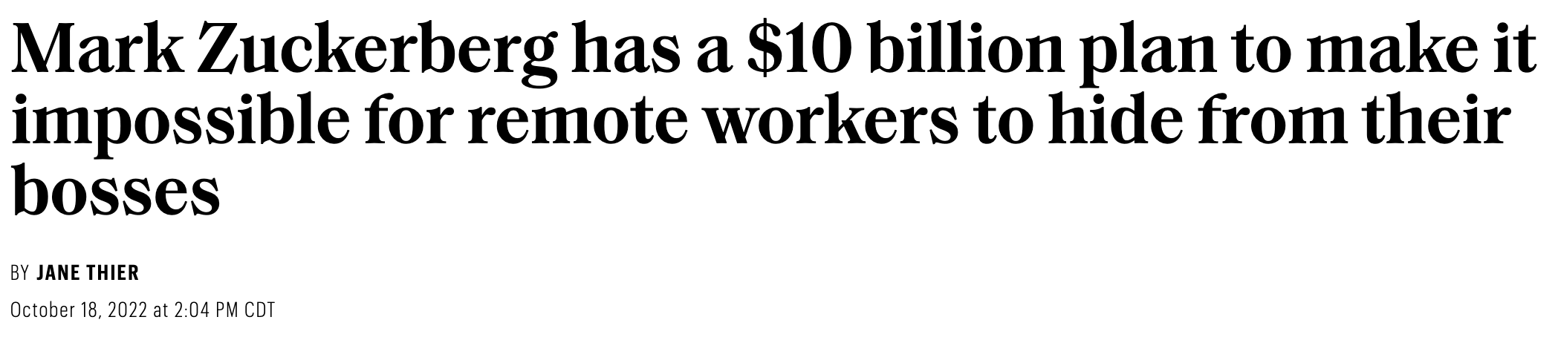
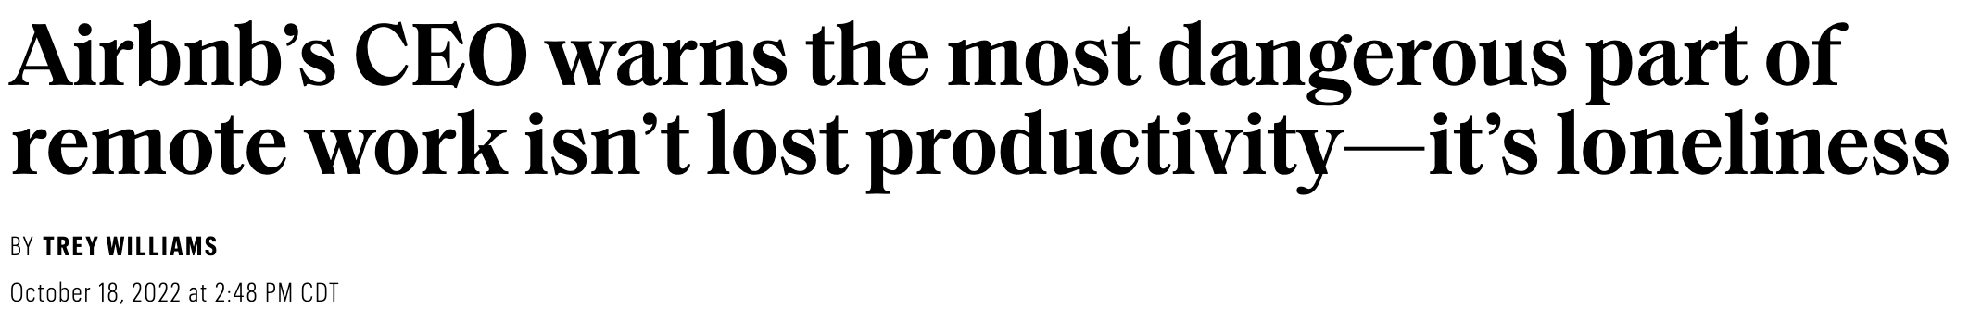

Slide 13
Future of Work
One of NSF’s 10 Big Ideas:
“In 2019, NSF will invest $30 million in each Big Idea and continue to identify and support emerging opportunities for U.S. leadership in Big Ideas that serve the Nation's future.”

Slide 14
Discussion
From workers’ perspectives, what do you think are “wrong” for the current crowdsourcing platforms? How do you think we can fix it?
To put the questions into context, consider the following question
What do you think are the most pressing questions related to the theme of “future of work”?
“Can we foresee a future crowd workplace in which we would want our children to participate?”

Slide 15
Improving Worker Welfare
Discussion among researchers [Kittur et. CSCW 2013]
Create career ladders
Motivation, job design, reputation, hierarchy
Improve task design through better communications
Quality assurance, job design, task assignment, real-time crowd work, synchronous collaboration, platforms
Facilitate learning
Reputation and credentials, AIs guiding crowds, crowds guiding AIs, task assignment, quality assurance
Various guidelines for conducting crowdsourcing
Guidelines for Academic Requesters
Responsible Research with Crowds: Pay Crowdworkers at Least Minimum Wage

